Slide 1

Offense vs. Defense
Arshiya Khan
Ph.D. Candidate, ECE
University of Delaware, USA

Slide 2
Agenda
Cybersecurity
Cyber Threats
Phishing Attack
Wireshark
System Hardening

Slide 3
Cyber Security
Computer and Network Security
Preserve CIA
Confidentiality
Integrity
Availability
C? I? or A?
Credit card numbers are stolen
Car
Broken
Stolen

Slide 4
Cyber Security
C? I? or A?
A user has gained root privileges on an E-commerce website. Changed the domain name of the website. Put all items on 50% discount.

Slide 5
Cyber Threats
Snooping
Spoofing
Alter
Masquerade
Modify
DDoS
Potential Violation of CIA
Classes:
Disclosure – Unauthorized access to information
Deception – Acceptance of false data
Disruption – Interruption or prevention of correct operation
Usurpation – Unauthorized control of some part of a system
SQL Injection Attack
Try it!
Classify?
Delay
Man in the Middle

Slide 6
Phishing Attack
Social Engineering technique
Collection of personal data carried out illegally or fraudulently through the internet
Use the information collected to make purchases online, bank transfers or cash withdrawals on behalf of the fraud victim
Examples

Slide 7
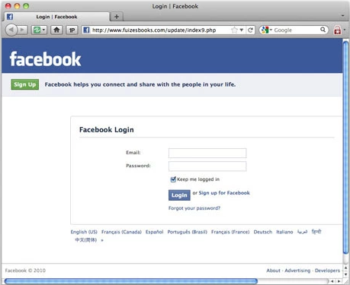
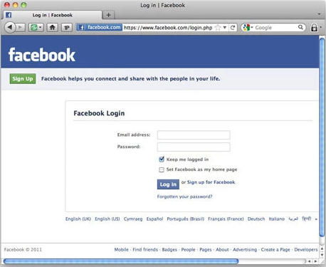

Slide 8
Wireshark
Network Packet Analysis
Install software https://www.wireshark.org/
Examine http://mailtranscripts.com/

Slide 9
System Hardening
Defensive policies and steps to make your system difficult to hack
Computer Hardening
Network Hardening
https://www.thefanclub.co.za/how-to/how-secure-ubuntu-1604-lts-server-part-1-basics

Slide 10
Thank You!

